Slide 1
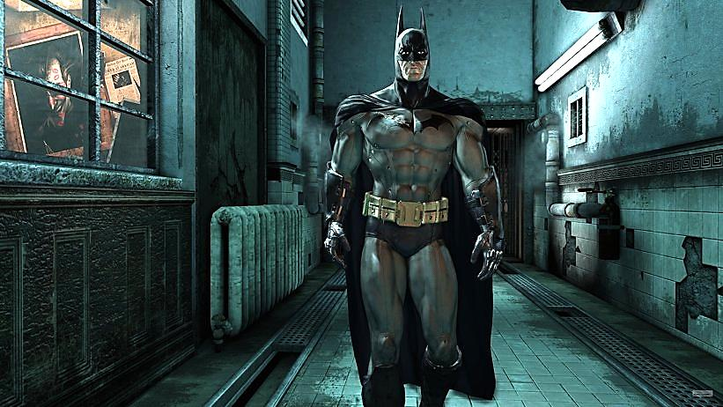
“I’m Batman”
Part Two

Slide 2
Note: Any videos in this presentation will only play online. After you download the slideshow, you will need to also download the videos from YouTube & add them back into your PowerPoint.
We present these messages at Bee Creek Park in College Station, TX. If you would like to watch the video of the service with this message, click here:
http://campaignkerusso.org/?p=11080
We would love to know more about the people who download our lessons & sermons. We invite you to email us & let us know where & how you use them.
info@ckbrazos.org

Slide 3
Next Slide: Song – “Speak to Me” Download Here: http://youtu.be/wcUOa96Zu98

Slide 4
“I’m Batman”
Part Two

Slide 6
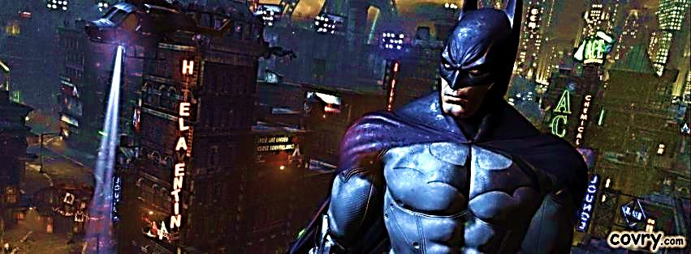
I’m Batman (pt. 2)
This cartoon character is based on a man who has acquired some bat attributes (and gadgets).
He is not real, but in the spiritual realm, believers are indeed equipped with special gifts that make them operate differently than average humans. Some of these abilities can be compared to bat traits.

Slide 7
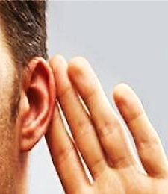
How to Get Heavenly Bat Ears
When we hear God’s Word (with an open heart) God develops our “spiritual ears.”
The bible calls this “ears to hear” or “hearing.”
These special ears produce faith in us.
“…faith comes by hearing, and hearing by the word of God.” Romans 10:17

Slide 9
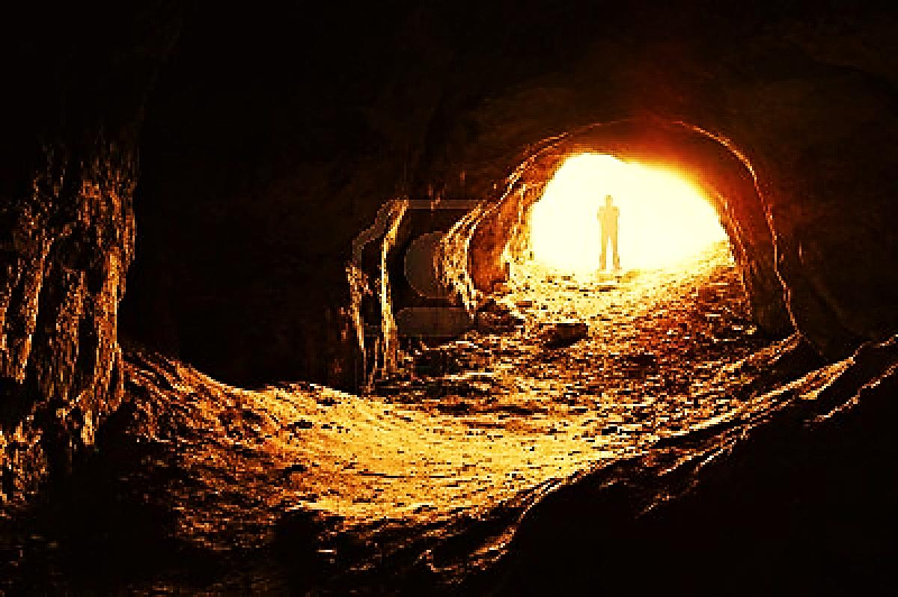
We Need Cave Time
First, we need to hear the Word (get some cave time) and then it can begin to heal our broken consciences and revive our dead faith.
“The word is near thee, even in your mouth, and in your heart. This is the word of faith…”
Romans 10:8

Slide 10
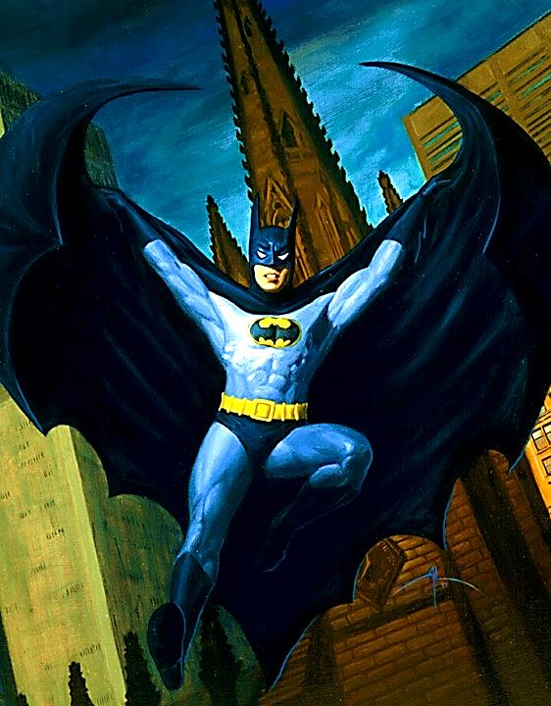
God’s “batman” soars fearlessly on his missions, believing what he has heard from God!
“…what you hear whispered in the ear, proclaim upon the housetops.”
Mat.10:27

Slide 11
So far: With bat ears (or God’s hearing), we can SEE & we can SOAR. Today, we will watch what we SWALLOW!!
Bats use echolocation to hit an insect with sound waves, understand what it is, catch and eat it in mid-air!
Bats are so good at this, it is almost impossible to trick them. In a series of experiments, scientists threw things like rocks in front of bats. →

Slide 12
With God’s Ears We Eat Good Food
The bats sent out sound waves and “saw” the rocks, but they did not try to eat them as they would a flying insect.
Somehow the bats are able to tell by the echoes whether or not the object is something that can be eaten! How amazing is that?!

Slide 13
With God’s Ears We Eat Good Food
When we read or hear the Word of God wearing our “Heavenly bat-ears,” we become wiser. We begin to make better choices. We know what to swallow and what to just ignore.

Slide 14
“We always thank God that you believed the message we preached. It came from him, and it isn’t something made up by humans. You accepted it as God’s message, and now he is working in you.” 1 Thess. 2:13

Slide 15
A man walked into a small grocery store to buy a box of cereal. He was amazed to see every shelf in the store filled with jars of mayonnaise. He told the owner of the store, “I want to buy a box of cereal but I can’t find any.” The grocer said, “It’s in the basement. Follow me.” →

Slide 16
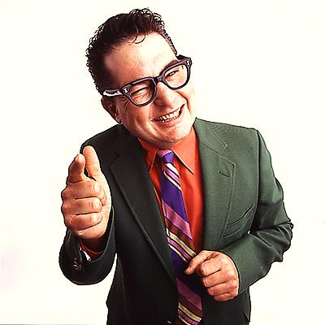
With God’s Ears We Eat Good Food
They went down into the basement and it too was filled with cartons and cartons of mayonnaise. The man said, “Wow, you must sell a lot of mayonnaise!” The grocer said, “No, I don't sell much mayonnaise. But the guy who sells me mayonnaise—boy, can he sell mayonnaise!”

Slide 17
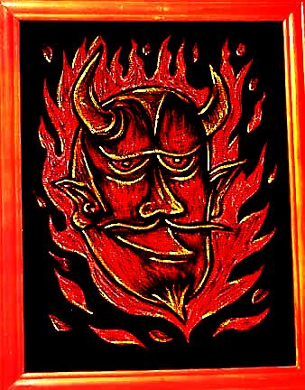
Some people will buy anything if the salesman is convincing enough. Satan is an excellent salesman!
If we hear teachings and advice and aren’t listening with “spiritual ears” (developed through bible study), we will be buying into lies.
We will be vulnerable to swallowing all kinds of junk.

Slide 18
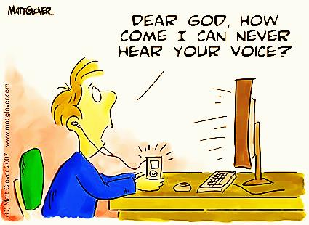
“…They come and sit in front of you as My people, and listen to the words you say. But they do not do them. With their mouth they speak of love, but their hearts are full of sinful desire.” Ezk. 33:31
So why can’t we hear and receive what God is saying to us? Our sinful desires are like wax in our ears.

Slide 19
Wax in God’s Heavenly Bat Ears
“They think of you as nothing more than one who sings love songs with a beautiful voice and plays music well. For they hear what you say, but they will not do it. Ezk. 33:32
We say, “Great sermon pastor,” but it doesn’t change our life.

Slide 20
Covetousness is Wax in Our Ears
This is how Satan was able to deceive Eve
“The woman stared at the fruit. It looked beautiful and tasty. She wanted the wisdom that it would give her, and she ate some of the fruit. Her husband was there with her, so she gave some to him, and he ate it too.” Gen. 3:6

Slide 21
Covetousness is Wax in Our Ears
She coveted the food with her belly
With her eyes , attractive things
With her pride, hidden knowledge
Listening to Satan made her stop listening to God who had said “You shall not eat of it.” She was soon easily deceived.
She had wax in her spiritual ears and was soon buying into lies.

Slide 22
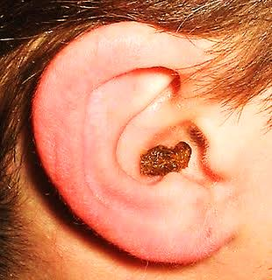
Covetousness is Wax in Our Ears
“They will turn away from the real truth you have to offer because they prefer the sound of fables and myths.” 2 Tim. 4:4

Slide 23
When you drive away from a radio tower, the signal gets weaker but, if you turn around and drive toward it, it gets stronger.
We stop hearing God when we drift away from Him. If we turn around and come back to Him, we hear His voice again.
The closer we are to God, the more clearly we hear Him.

Slide 24
We need to spend time in God’s bat-cave. Spend time in His word, prayerfully taking it to heart, loving it.
We need to come to church to listen, clear the wax build up of sin and listen to what God is speaking to us personally.

Slide 25
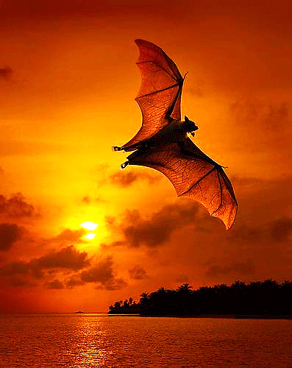
When we have heard God’s Word with God’s special “hearing” gift, we will:
SEE and no longer be blind
SOAR with faith and do brave things for God
SWALLOW only truth

Slide 26
Next Slide: Song – “Speak to Me” Download Here: http://youtu.be/wcUOa96Zu98

Slide 27
Is Jesus Speaking to You?
“They said to each other, ‘Did not our hearts burn within us while he talked to us on the road, while he opened to us the Scriptures?’”
John Wesley Said:
“…the preacher was describing the change which God works in the heart through faith in Christ and I felt my heart strangely warmed.”
Jesus makes His presence Known by a small voice!

Slide 29
What is the Sinner‘s Prayer?
This is a prayer we can pray when we are ready to admit we are sinners and need Christ’s forgiveness.
It must be prayed with faith in our hearts and a readiness to have a life-changing encounter with Jesus Christ.

Slide 30
A prayer of faith → Pray this prayer if :
If you never have before
You have in the past, but you think it would mean more today
You have been walking afar off and you want to come back
You want to set an example & show others how it is done
You just like to give your heart to Jesus again & again
Faith

Slide 31
We Declare Our Faith Publicly Because Jesus Declared His LOVE Publicly
“If you stand before others and are willing to say you believe in me, then I will tell my Father in heaven that you belong to me.” Mat 10:32

Slide 32
Important Questions
Do you want to know Jesus as your Savior right now?
Do you believe He died to save you from your sins & that He rose from the dead?
Do you believe that He is here, waiting to save you right now?

Slide 33
The Prayer of a Sinner Turning to Jesus
Dear Jesus, I know that I have sinned against You and that my sins separate me from You.
I am truly sorry.
Right now, I turn away from my sinful past .
Please forgive me, and help me to keep from sin.
I believe You died for my sins.
I Believe You rose from the dead, you are alive, and you hear this prayer from my heart.
I invite You Jesus to be both my Savior and the Lord of my life.
I want You to rule my life from now on.

Slide 34
“But some people did accept him. They believed in him, and he gave them the right to become children of God.”
John 1:12

Slide 36
“If you openly say, ‘Jesus is Lord’ and believe in your heart that God raised him from death, you will be saved.”
Rom. 10:9
What did you learn today?
What is the meaning of the name-tag?
What have you been thinking about God lately?
What do you want to tell the world about Jesus?

Slide 37
“Draw near to God, and He will draw near to you…
Altar Time
…Cleanse your hands, you sinners, and make your hearts pure, you who are half-hearted towards God.” James 4:8 WNT

Slide 38
Close in Prayer

Slide 39
Note: Any videos in this presentation will only play online. After you download the slideshow, you will need to also download the videos from YouTube & add them back into your PowerPoint.
We present these messages at Bee Creek Park in College Station, TX. If you would like to watch the video of the service with this message, click here:
http://campaignkerusso.org/?p=11080
We would love to know more about the people who download our lessons & sermons. We invite you to email us & let us know where & how you use them.
info@ckbrazos.org

Slide 40
Welcome to Aggieland Faith Family Style Worship

Slide 41
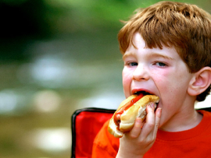
CURRENT SCHEDULE: See www.Aggielandfaith.org
SATURDAY —
At Bee Creek Park
2:00-4:00pm: Through the bible with felt-board stories – plus hot-dogs & drinks
SUNDAY —
At Bee Creek Park
2:00-4pm: Free snacks, drinks, kids crafts, prizes, singing & bible preaching

Slide 42
Would You Like Prayer or Bible Study at Your House?
Personal Prayer: We can come to your home & pray with you, or you can email us when you need prayer.
Home Bible Study: We will come to your home & hold a bible study for you & your friends.
Bible Party: We will hold a Kid’s Bible Party: You provide the food & kids - we will do the bible fun & stories.

Slide 43
Would You Like Visitation?
We will visit a friend, loved one in the hospital or in prison to pray for them & share Christ with them.
Contact: info@aggielandfaith.org

Slide 44
www.aggielandfaith.org
Go here to see pictures & videos
Go here to subscribe to e-mails about changes & cancellations

Slide 45
Note: Any videos in this presentation will only play online. After you download the slideshow, you will need to also download the videos from YouTube & add them back into your PowerPoint.
We present these messages at Bee Creek Park in College Station, TX. If you would like to watch the video of the service with this message, click here:
http://campaignkerusso.org/?p=11080
We would love to know more about the people who download our lessons & sermons. We invite you to email us & let us know where & how you use them.
info@ckbrazos.org

